Slide 1

Building a secure, ethics-first AI solution (morning session)
Level 6 AI/ML Engineer
Higher Apprenticeship
Workshop 1

Slide 2

Wellbeing Check & Safeguarding
What is one nice thing you have done this (or last) week for your own self-care? Brainstorm some ideas.
Is there any support that you need?
What does “inclusivity” mean to you?
Remember the email address: safeguarding@corndel.com

Slide 3
Workshop Objectives
By the end of this workshop, learners will be able to:
Build and visualise a secure, ethical AI pipeline
Collaboratively analyse real-world pipeline risks, showcasing prioritisation and risk mitigation
Professionally document practical lessons learned.
Identify and critically examine how ethics and governance shape practical AI design and deployment decisions
Referring to the KSBs gained from this workshop, argue how personal ethical responsibilities shape an AI engineer’s learning focus and how ethics informs your own choices as an AI engineer.

Slide 4

Workshop Structure
These morning slides including discussion will take 45-50 minutes to complete.
The main hands-on element will follow. That can be completed in 3-5 hours.
There will be some additional slides throughout the afternoon.

Slide 5

Key concepts
Asset
Anything valuable, be it a thing or a person or a digital artifact, that should be protected (including models, data, infrastructure, etc.)
Risk Assessment
A systematic approach to identifying, describing, evaluating and prioritising potential problems before they happen.
Threat
A potential cause of unwanted harm or disruption (e.g. a bad actor exploiting a model vulnerability).
A weakness in the system that can be exploited and lead to threats, for example untested code, unsecured data, unvalidated inputs, model drift, etc.
Vulnerability

Slide 6
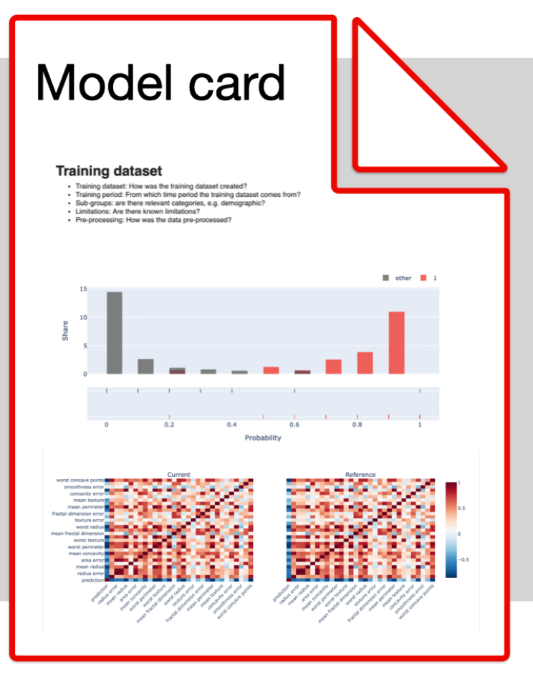
What are model cards?
Structured documents
often Markdown files with added metadata
Provide an overview of a model’s:
Purpose / intended use,
performance, limitations (and caveats),
training data, expected data,
key variables (factors), metrics,
and ethical considerations.

Slide 7
Group discussion: Model cards
In your group, come up with at least 1 scenario where a model card may be particularly useful
Brainstorm risks: what could happen if there was no model card?
How would you convince your stakeholders to use model cards? Come up with at least 1 argument

Slide 8
Useful Tool: The ODI Data Ethics Canvas main steps
Assessing
Assessing the Data and its purpose
Identifying
Identifying impacts and mitigations
Evaluating
Evaluating engagement and communication
Deciding
Deciding on next steps – actions and reviews

Slide 9
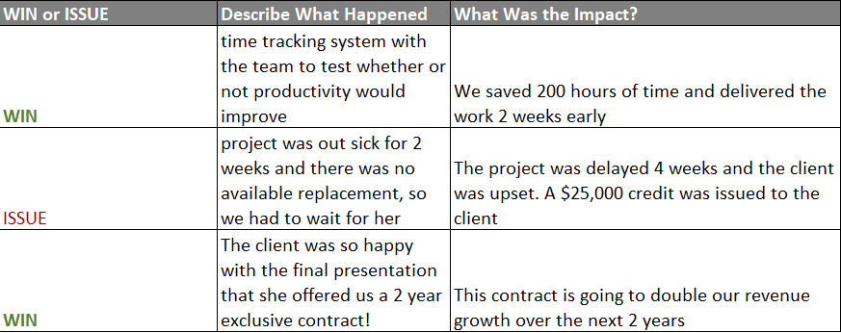
Useful Tool: Lessons Learned Log

Slide 10
Tips for Communicating with Stakeholders
Tailor technical detail to the audience’s expertise
Summarise root cause & next steps clearly
Use a “blameless” approach: focus on solutions, not blame
Provide realistic timelines for fixes or next checks
Document decisions in the incident log or communication templates

Slide 11
Important: Defining good problems is a key skill in ML (“ML problem framing”)
Vague problem statement: “We need AI to boost profits”
Improved: “We need an ML model to identify top-selling products, given historic data by region”
Ensure statements are measurable & relevant
Clarify success metrics (e.g., sales up by X% over 6 months)
Encourages more targeted engineering solutions

Slide 12
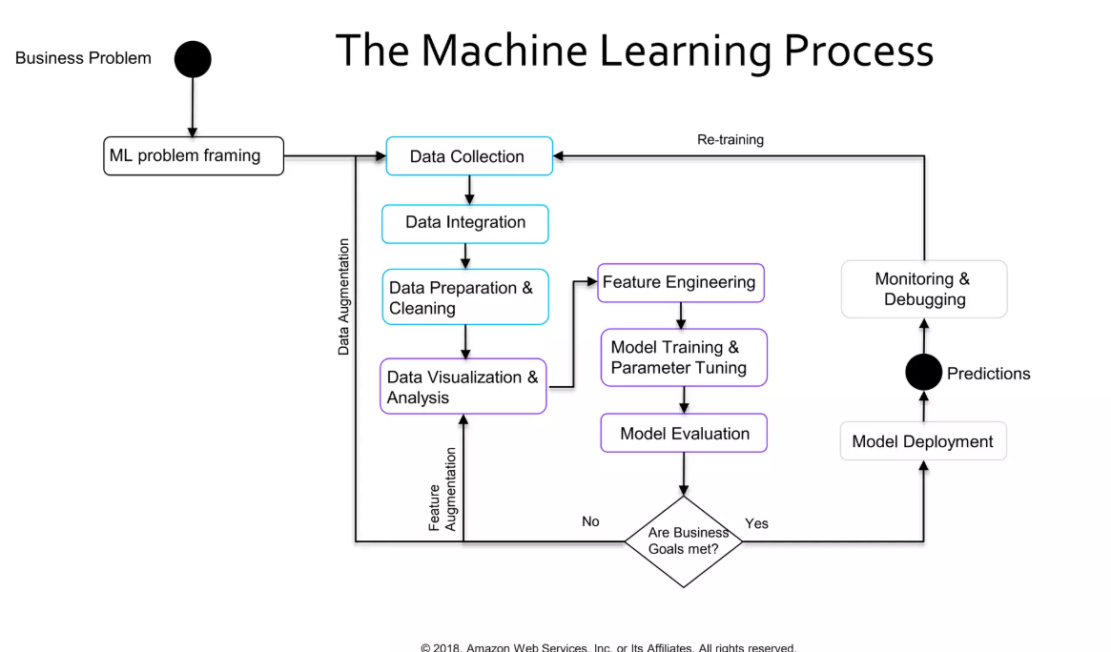

Slide 13
Active Listening Helps with ML Problem Framing
OFTEN WE NEED TO LISTEN TO OTHERS’ OPINIONS OF what WE ARE SOLVING/BUILDING.
IT IS IMPORTANT TO LISTEN WITHOUT INTERRUPTING AND WITH FULL FOCUS.
ACTIVE LISTENING SKILLS include: paraphrasing, summarising, clarifying (checking if your assumptions match the other person’s ASSUMPTIONS)
FOLLOW EVERY SPOKEN DISCUSSION WITH CROSS-CHECKING YOUR written NOTES WITH OTHERS (YOU CAN ALSO USE AI to help transcribe and summarise)

Slide 14
Effective Communication = Active Listening + Clear Explanations + Effective Questioning

Slide 15
What helps with effective questioning?
Aim for clarity: “Can you show me an example?”
Prefer precise questions over vague (“How to predict our turnover” over “How to best utilise AI”)
Encourage the stakeholders to add context and constraints. (E.g. “how to predict turnover in sales for the next quarter”)
Avoid jargon that might confuse the conversation. The best questions are often about how to predict something useful!

Slide 16
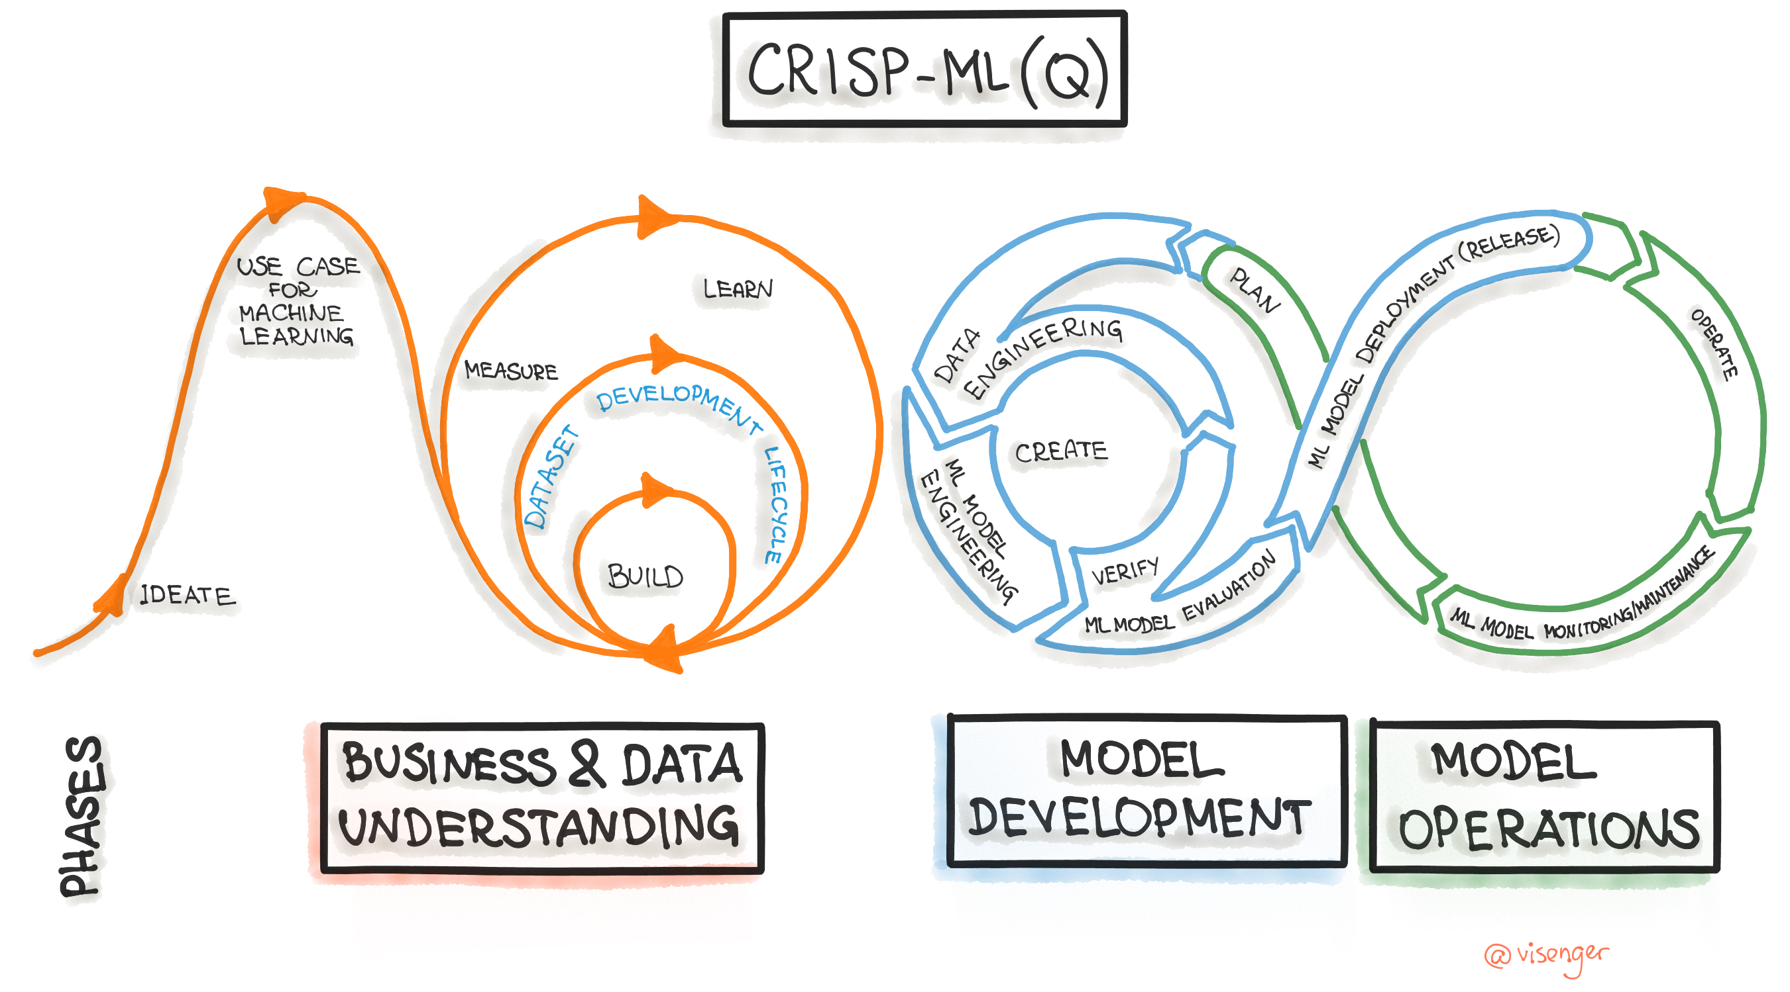

Slide 17
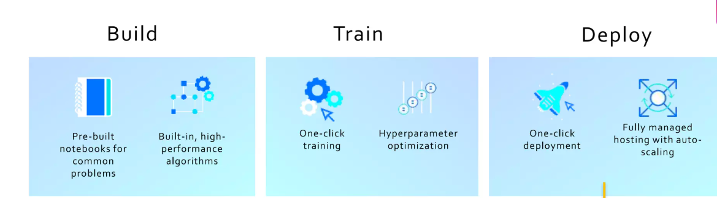
How does CRISP-ML(Q) map to Sagemaker

Slide 18

Will Peter get a loan ?
Reject?
Defaults?
Salary?
Approve?
Electoral roll?
Oldest credit line?
Postcode?

Slide 19
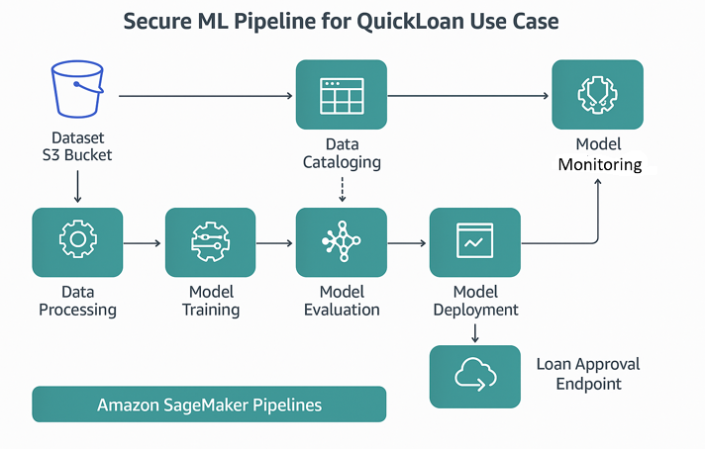
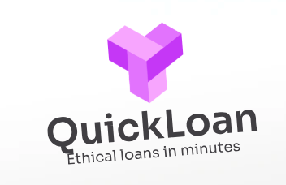

Slide 20

Your PDE will guide you through the remaining hands-on exercises

